Slide 1
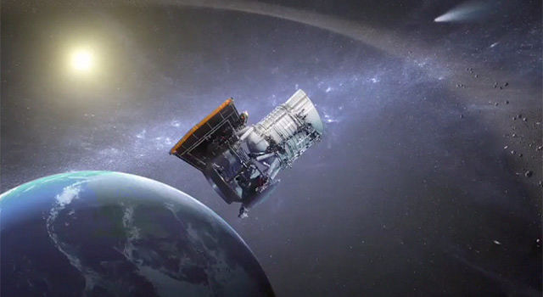
Near Earth Object Analysis Rovers
ROMULUS
Tazeen Ajmeri
Rome Ramos
Daniel Tchorni
Bharat Shamsukha

Slide 2
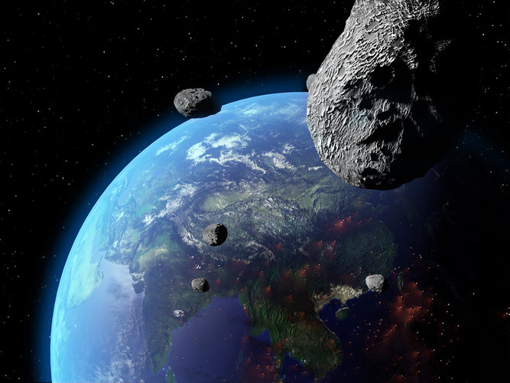
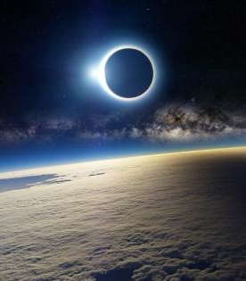
The Problem
Executing Missions to Analyze NEOs:
- Are very time consuming
- Cost a lot of money
- Require large amounts of energy
Notes:
is how long it takes to plan and execute missions to analyze near earth objects (NEOs)

Slide 3
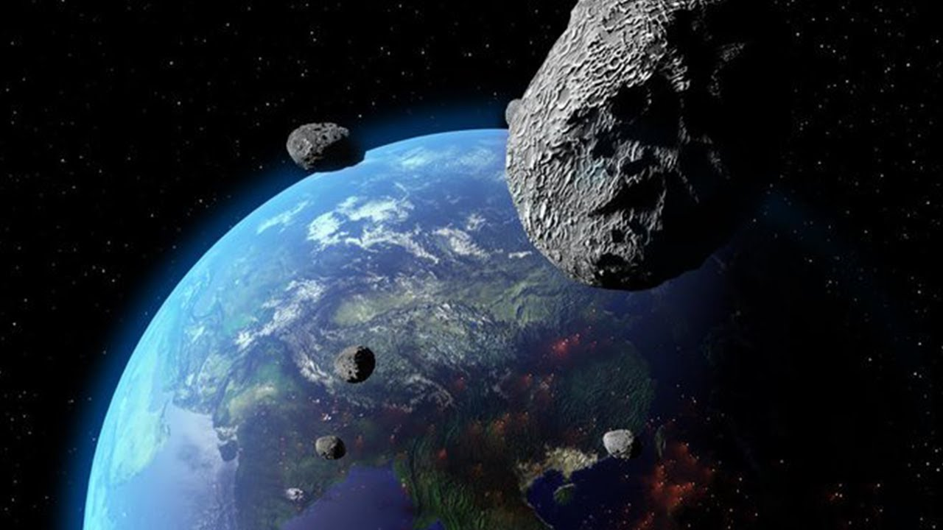
The Solution? Romulus!
A team specializing in analyzing NEOs by rovers
Our goal is trying to land a small rovers on an incoming NEOs

Slide 4
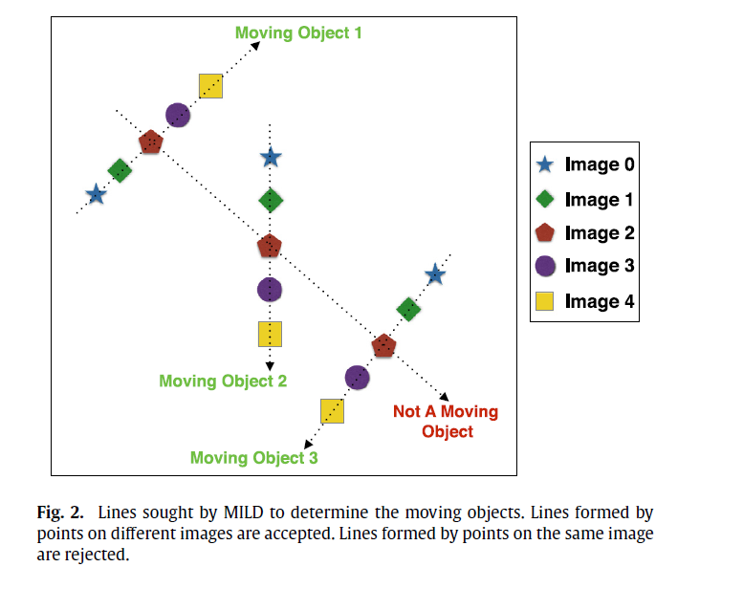
Finding Near Earth Objects
Automated Solution: A-Track
Methods: MILD
- Multiple
- Image
- Line
- Detection
Fig 2: Atay, T., Kaplan, M., Kilic, Y., Karapinar, N., 2016, A-Track: A new approach for detection of moving objects in FITS images, Computer Physics Communications, Volume 207, p. 524-530.
Notes:
Akdeniz University Turkey
Highlights objects moving across multiple images and using the MILD technique. A-track solves for potential NEO's objects and then uses Astrometry to identify there location in the sky.
There is an additional library used by A-track to find these solutions, however not all inputs will result in solutions.

Slide 5
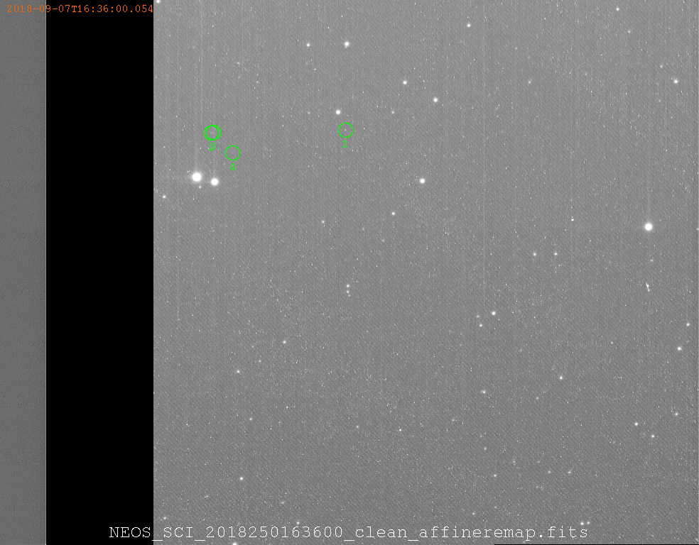
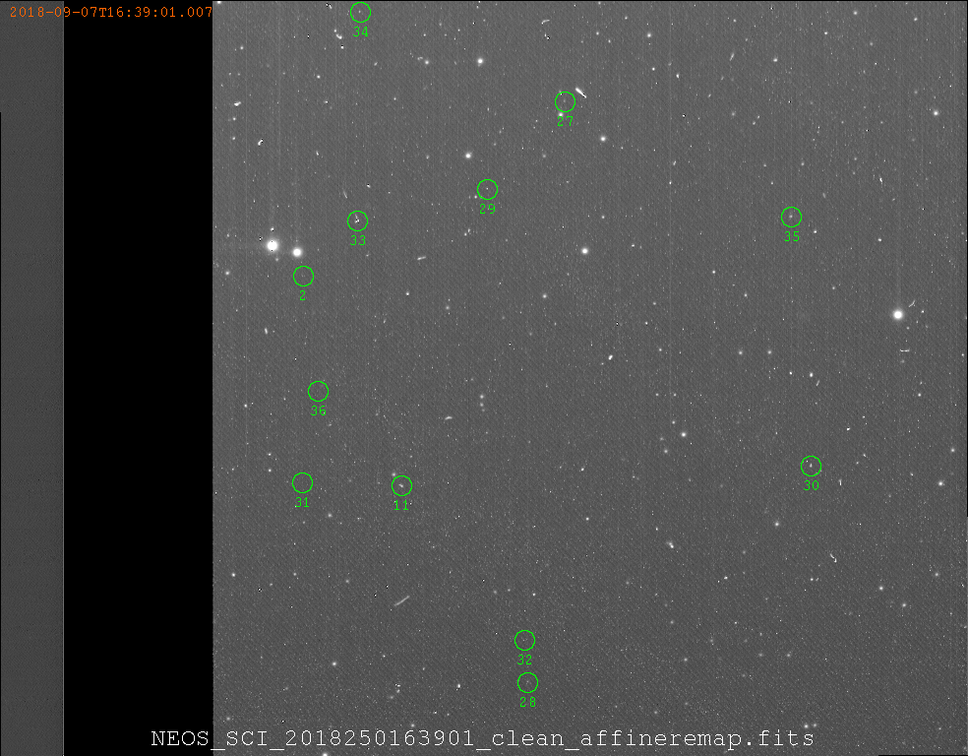
Some Results...
Notes:
Akdeniz University Turkey
Input-data was taken from Sept 7th of 2018-RC, a day after its close encounter with earth
Highlights objects moving across multiple images and using the MILD technique. A-track solves for potential NEO's objects and then uses Astrometry to identify there location in the sky.
There is an additional library used by A-track to find these solutions, however not all inputs will result in solutions.

Slide 6
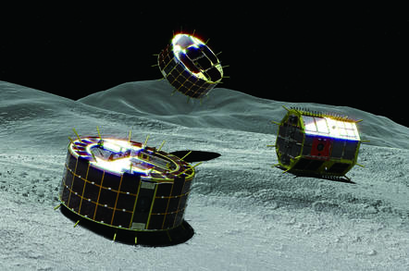
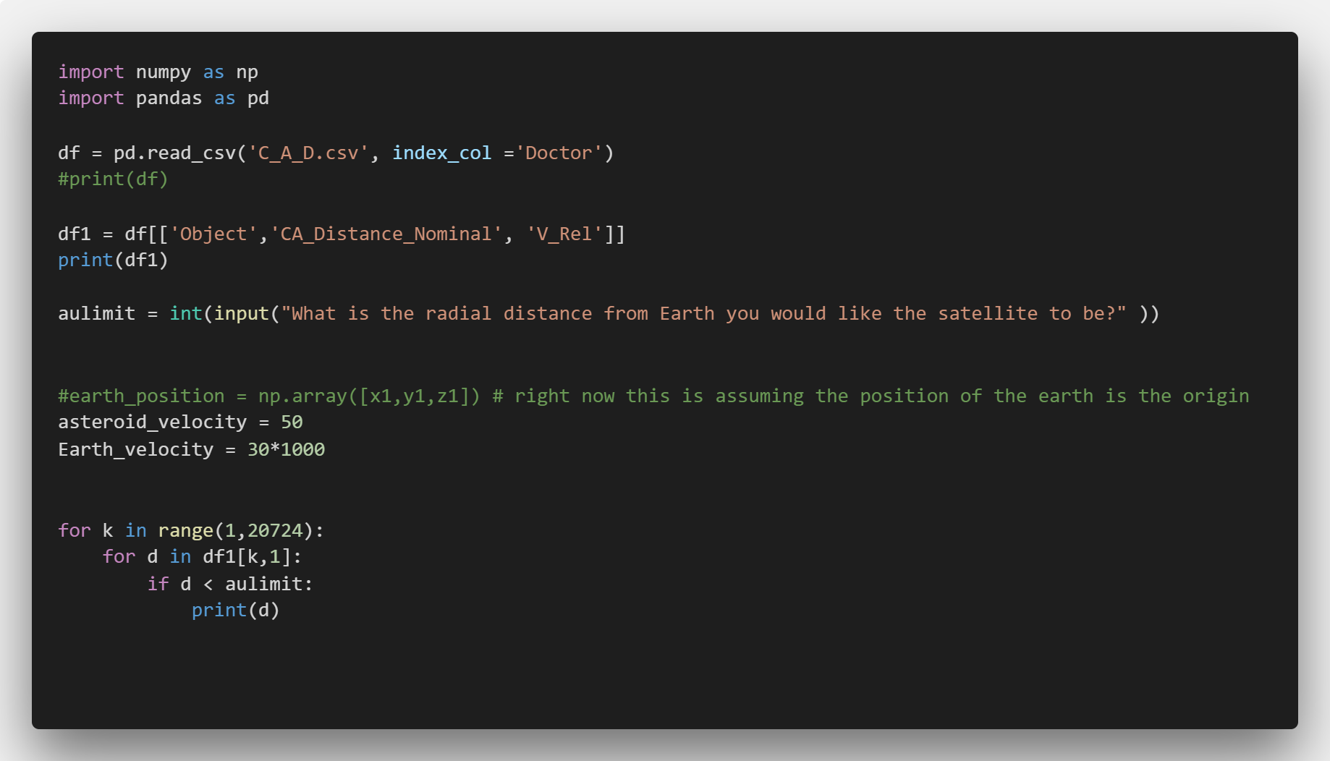
Introduction to Analysis of NEO Trajectories

Slide 7
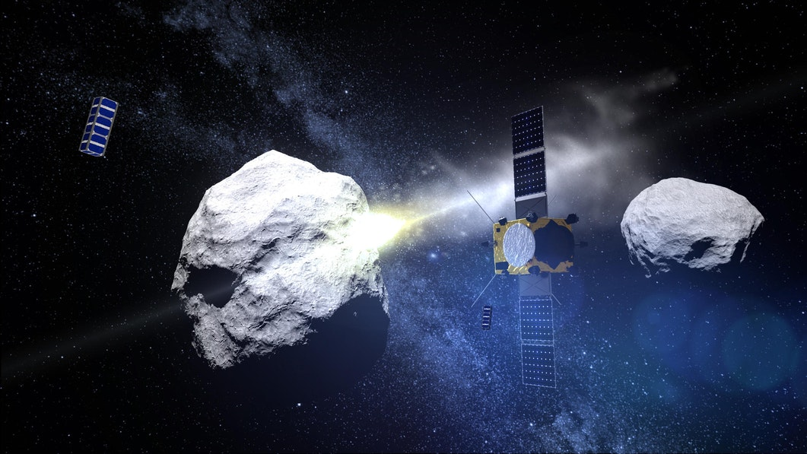
Impact and Why?
Insight about the origins of the solar system
Mining NEOs could give information about the composition of planets
Mining NEOs could provide us with rich minerals
Notes:
Do asteroids have a gravitational field?
Yes asteroids have gravitational fields but are very weak. However over a of few million years these small asteroids combine together to form large masses of bodies that are turned into planets. Every planet that you see or know used to be an asteroid at some point during its evolution.

Slide 8
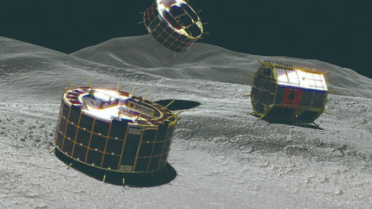
Thank you!
- Romulus -

